Slide 1

CaPSS is delivered within the Australian Government’s Families and Communities Program (Department of Social Services). Visit www.dss.org.au for more information.
Children and Parenting Support Service (CaPSS) operates in Melbourne’s outer west.
We provide support to parents to raise happy and healthy children

Slide 2


Children and Parenting Support Service (CaPSS) works with families who have children aged 0-18, with a primary focus on families with children aged 0-12.
CaPSS provides early intervention and prevention services and resources that are aimed at improving children’s development and wellbeing plus supporting the capacity of those in a parenting role. ​
Practitioners work alongside those in a parenting role, both in groups and with individual families, enabling and empowering opportunities for change using practical and evidence-based strategies. We make appropriate and timely referrals to other services or work in collaboration to help support our clients where and when needed.

Slide 3
CaPSS offers 3 key areas of support to those who are in a parenting role
Individual 1:1 Parenting Support ​
Tailored support to help improve your parenting skills and achieve your best parenting goals.​
Facilitated peer-to-peer parent support ​
Supporting parents and families to feel comfortable to participate in community life and to reduce risk of isolation.​
Group parenting skills programs​
Including playgroups, evidence-based workshops and evidenced group programs for parents and children.

Slide 4
Where do we operate?
We deliver and run programs online and out of the spaces mentioned below-
CaPSS Central office, 38 Station Road, Melton South (resuming in person events from Term 1, 2022).*
The Salvation Army, Wyndham Corps, 211, Watton Street, Werribee.*
Online – via Webex, Teams or Zoom
Community centers, parks, Bunnings, schools, libraries, etc.*
At your residence for 1:1 parenting support or in a local park or café.*
List of suburbs we assist-
City of Hobsons Bay- Laverton
City of Melton- Brookfield, Cobblebank, Exford, Eyenesbury, Harkness, Kurunjang, Melton, Melton South, Melton West, Parwan, Strathtulloh, Toolern Vale, Weir Views
City of Wyndham- Hoppers Crossing, Little River, Manor Lakes, Werribee, Williams Landing, Wyndham Vale
Please Note- To attend our group programs, parents/carers/families from any suburb are welcome, but to be eligible for 1:1 parenting support, they need to be living in the suburbs listed above.
*Contact our office staff to know more about our office hours and session delivery, as we aim to follow all Covid safe protocols.

Slide 5



CaPSS has 3 portfolios:​
​ Aboriginal and Torres Strait Islander Families​​
​Building programs that are informed by the community and cater to needs arising for Aboriginal and Torres Strait Islander families as identified by them. ​
For more info call Charmaine on 0475 976 071.​
Men as Fathers​​
​Working to strengthen men’s role as fathers and build healthy relationships with their children, thereby encouraging them to co-parent amicably with their partner or former partner. ​
For more info call Shaun on 0455 521 154.​
​
Rainbow Families​
Aims to assist people who are LGBTQIA+ and parenting to foster community connections and strengthen family function and cohesion for families of LGBTIQA+ youth. ​
For more info call Alex on 0456 824 447.

Slide 6

Some of the services we provide:
Ongoing parent support groups:

Slide 7
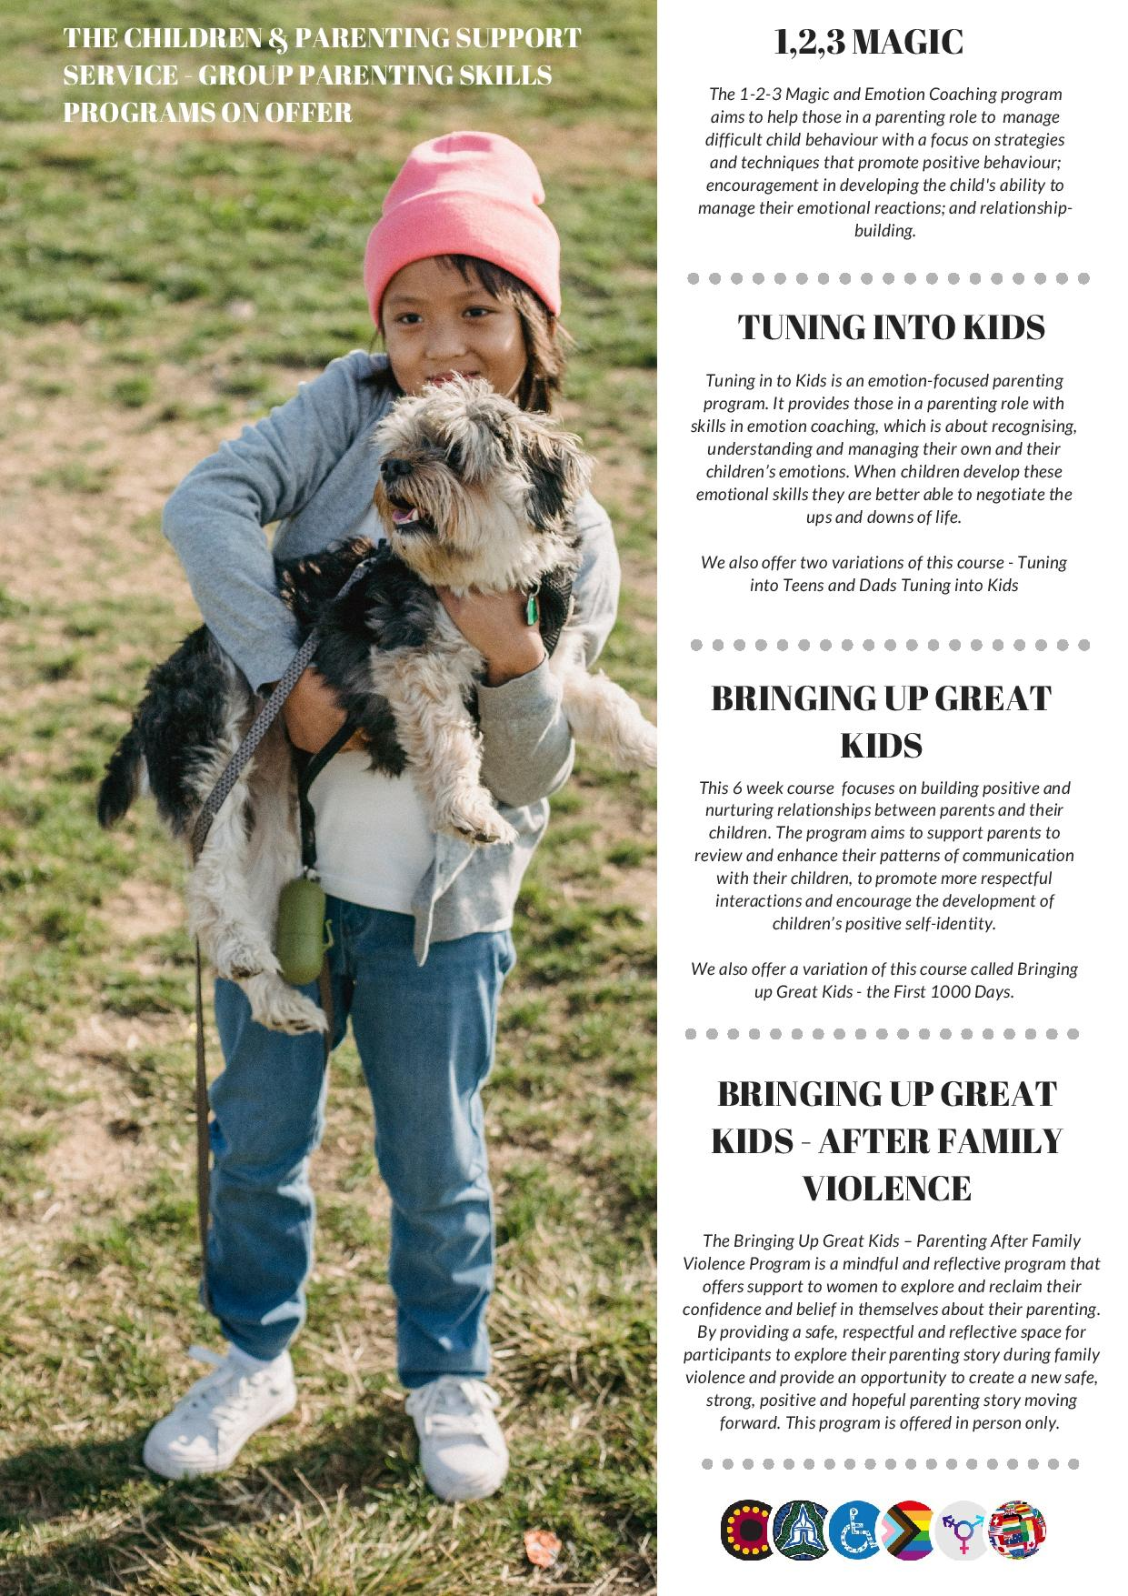
Courses we offer*
*All our programs can be delivered in person or online, on demand or due to pandemic restrictions.

Slide 8
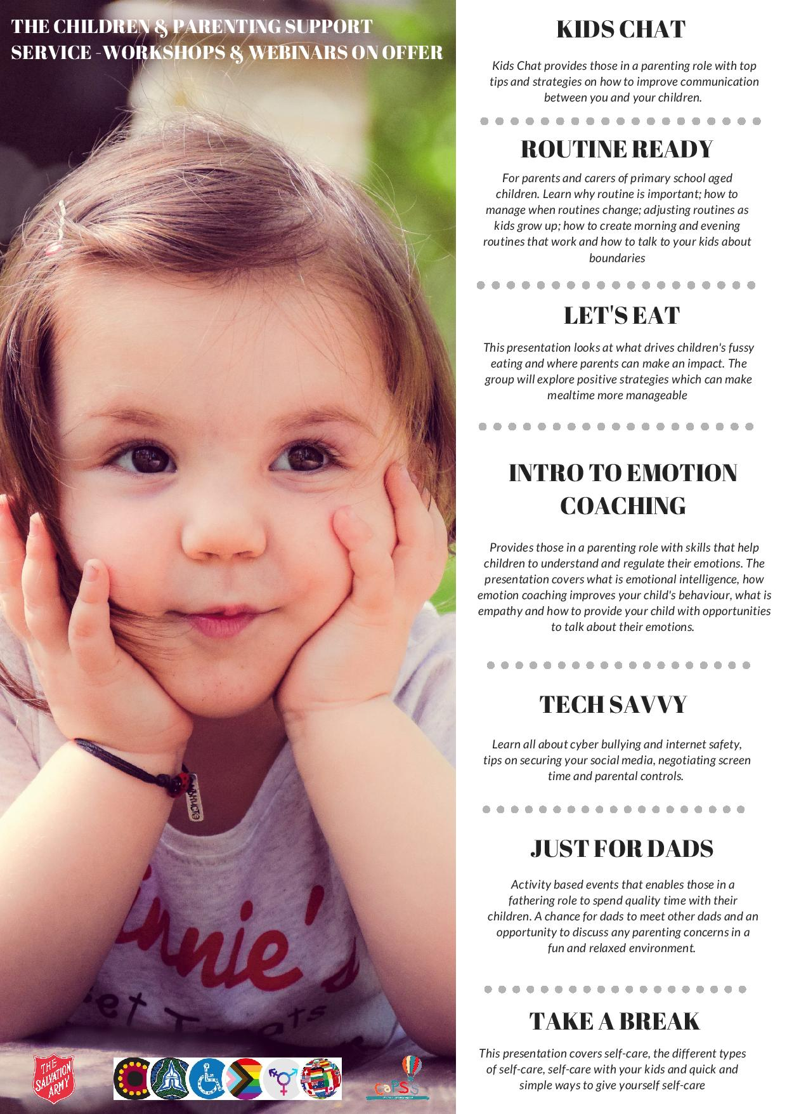
Webinars on offer* -
*45-60 minutes, short and once of workshops /webinars on offer, in person and online

Slide 9

Self referral and agency referrals accepted
We do early intervention where needed for 6-8 sessions of one-to-one parenting support*

Slide 10
CaPSS online and social media service channels
Facebook: @Children and Parenting Support Service*
https://www.facebook.com/capssmeltonwyndham
Instagram: @capssmeltonwyndham
https://www.instagram.com/capssmeltonwyndham/
CaPSS Resource Guide: https://capss.us14.list-manage.com/subscribe?u=3c5b57ee837cb04685dd36528&id=8e57481fe9
Express interest in any of our programs: https://www.surveymonkey.com/r/CaPSSjg ​​
Sign up for our monthly newsletter: http://eepurl.com/cfjSpP
​
*CaPSS has nearly 100 videos on our Facebook page with evidence-based parenting strategies, fun family activities, and other ideas for the whole family:​ www.facebook.com/capssmeltonwyndham/videos/

Slide 11
​
QUESTIONS
Or contact us via-
Email: capss@salvationarmy.org.au ​
Phone: Greg on 0409 608 551 or Neha on 0475 976 072​​
Website: https://www.salvationarmy.org.au/sashs/programs/children-and-parenting-support-service-capss/ ​
(soon to be updated)​
DM us on our Facebook and Instagram accounts.

Slide 12
Thank You!

