Slide 1
Middle Years Counselling Service
COMMUNITY SUPPORT – YOUTH SERVICES
Jake Todaro – Youth and Family Counsellor
Notes:
Hi everyone! So firstly I’ll just introduce myself. My name is Jake and I work in the youth counselling team in youth services at Wyndham City. Today’s presentation is just to introduce you all to youth services’ new counselling service which is targeted at children aged 8-11 and/or their parents/carers.

Slide 2
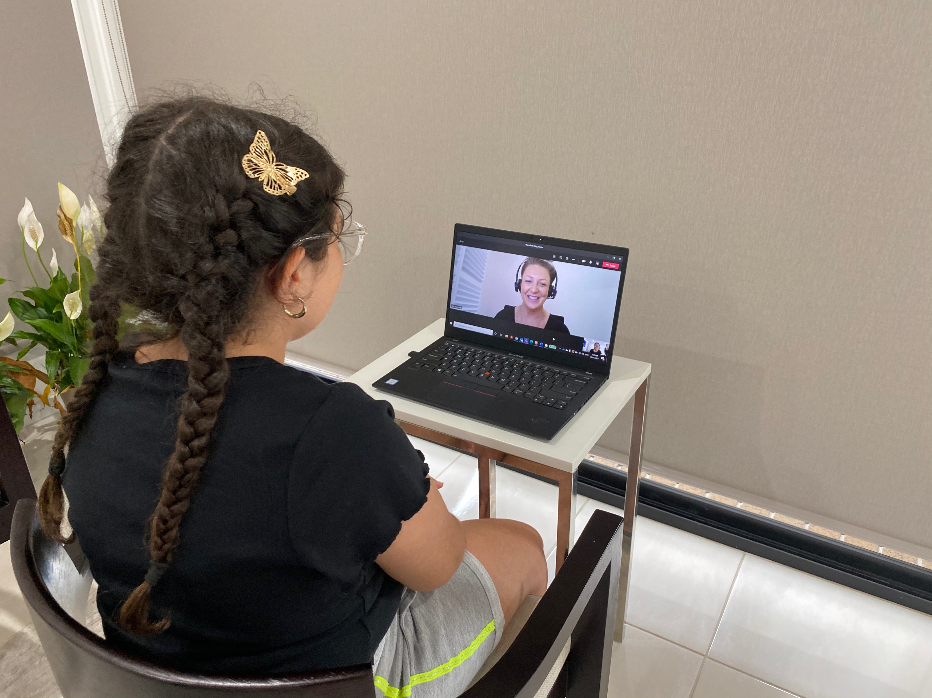
Agenda
Gaps in counselling service
Cohort
Eligibility criteria
Counselling Process
How to access
middle years counselling
Counselling team
Summary
Notes:
So here is just an agenda of what we will be discussing today.
Firstly, we are going to discuss the current gaps in our counselling service relating to this middle years cohort
We will look at the cohort itself
We will also look at the eligibility criteria. So who can access service and what requirements must be met in order for someone to be eligible
I will also walk you through a brief introduction into the counselling process and what the counselling pathway might look like as well as how to access our new service
And I will finish off with showing you the current counselling team and following up with a summary of today’s presentation

Slide 3


Gaps in Counselling Service
Counselling restricted to young people aged 12-25
Lack of counselling accessibility to younger audience, important developmental period ¹
Identified need for mental health support in middle years cohort across Wyndham²
¹ Australian Research Alliance for Children and Youth (2011)
² Wyndham City (2019)
Notes:
Previously Wyndham City’s counselling service only offered counselling to young people aged 12-25 and their families.
Through anecdotal, observational, and research evidence there was a notable need for accessibility of counselling to younger clientele to address community needs. Early adolescence is a major developmental stage where there are significant physical, social, and neurological changes that can influence the child long term. Additionally in Wyndham specifically, there was an identified need for mental health support in a service audit (2019) for middle years counselling where 28 respondents addressed concerns over mental health and concerns over schooling engagement and over 50% of respondents identifying cost as barrier to accessing services for their child (which we will get into a little bit soon)

Slide 4

Cohort
Target audience:
  Available to children aged 8 – 11 and their parents or carers who work/study, live, or recreate within Wyndham and are seeking primary and early intervention counselling
Why is this important?
  Early and primary intervention helps support children and their families to improve outcomes and meet the needs at an early age ³
³ Good Shepherd Australia New Zealand (2017)
Notes:
Our target audience is children aged between 8-11 years old who lives, studies or recreates in Wyndham. Counselling sessions are voluntary so the child should not be compelled by referrer to attend. Additionally, our target audience is also parents/caregivers of children aged 8-11 years old who require counselling for their child and lives, studies, works or recreates in Wyndham. Wyndham is home to approximately 20,000 middle years children (8-12 years). With the largest number, 5,295 residing in the Point Cook, followed by Tarneit – 3,235 & Werribee – 3,026.
This is an important service to offer as children in this age group are at an important point in their life where they are building and strengthening important relationships with peers and may begin to experience academic pressures. It is imperative to have this service as an option if mental health concerns arise where we can address them through early and primary prevention in order to steer them toward a positive life course (Good Shepherd Australia New Zealand, 2017).

Slide 5
Eligibility Criteria
Child (or parent/caregiver) is:
  voluntarily wanting counselling.
  between 8-11 years old.
  Studying, living, recreating or connecting within Wyndham.
Free!
No mental healthcare plan required!
Notes:
Mention how easily accessibility of service

Slide 6
Counselling Process
Referral
Assessment
Intervention Session
Waitlist
Counselling 10 Sessions
Exit Plan
Child is referred to counselling service
Counsellor completes structured assessment and advises child and parent/caregiver on:
Intervention session is offered to child while on waitlist. This session is heavily influenced by the single session therapy model (SST).
Child is placed on waitlist and updated on progress
Counsellor sees child for up to ten sessions of counselling
Counsellor and child prepare an exit plan including strategies and appropriate referrals to other services if required.
a) eligibility, b) waitlist periods, c) suggested referrals if required.

Slide 7
How to Access Middle Years Counselling
Accessible through Wyndham City website; Services > Youth Services > Services and Programs > Community Counselling Support
https://www.wyndham.vic.gov.au/form/counselling-refform-parandprof
MiddleYearsCounselling@wyndham.vic.gov.au
Phone: (03) 8734 1355
Notes:
We have updated the landing page for community counselling support to have an information section on our middle years service included. An updated link to access counselling for all age groups has been added at the bottom of the page where it will lead to a hub with options to select which service suits the person best. The referral form has been updated to suit the new cohort and to cater for needing consent from the parent/guardian rather than allowing options for the young person to consent. The referral form, when completed, will be sent to middleyearscounselling@wyndham.vic.gov.au where one of our counsellors will assess initial eligibility and make contact to book an assessment with the child and parent/guardian.

Slide 8


Counselling Team
Gee Bilal - Area Leader Youth Support & Development
Email: Gee.Bilal@wyndham.vic.gov.au
Rosie Barbara - Youth and Family Counsellor
Mob: 0400 942 661
Email: Rosie.Barbara@wyndham.vic.gov.au
Jake Todaro - Youth and Family Counsellor
Mob: 0409 491 521
Email: Jake.Todaro@wyndham.vic.gov.au
Sherebanu Katawala – Youth and Family Counsellor
Mob: 0428 099 712
Email: Sherebanu.Katawala@wyndham.vic.gov.au
Maree Recupero – Youth and Family Counsellor
Mob: 0428 169 248
Email: Maree.Recupero@wyndham.vic.gov.au
Fran Power – Youth and Family Counsellor
Email: Frances.Power@wyndham.vic.gov.au

Slide 9

Summary
New counselling service offered for children aged 8-11 years old
Rollout began on January 11th, 2021
Access service by contacting MiddleYearsCounselling@wyndham.vic.gov.au OR
Phone: (03) 8734 1355
Notes:
Rollout began on January 11th however a soft promotion was rolled out on the 22nd of January and now we have already started receiving referrals!
So if you know anyone who would benefit from this service, please feel free to send this information around to those in need
Put links in this slide in Teams chat for people to access.
MiddleYearsCounselling@wyndham.vic.gov.au
Ph: (03) 8734 1355
https://www.wyndham.vic.gov.au/form/counselling-refform-parandprof

Slide 10

Questions

Slide 11



Thank you
Jake Todaro
Jake.Todaro@wyndham.vic.gov.au
0409 491 521
References
¹ Australian Research Alliance for Children and Youth. (2011). “betwixt and between”: A report on ARACY’s Middle Years Project. Retrieved from https://www.aracy.org.au/publications-resources/command/download_file/id/77/filename/%27Betwixt_and_Between%27_-_A_report_on_ARACY%27s_Middle_Years_Project.pdf
² Wyndham City. (2019). Middle Years Project Wyndham’s Middle Years children Report.
³ Good Shepherd Australia New Zealand. (2017). Bridging the Divide: Supporting children and young people in their middle years. Retrieved from https://goodshep.org.au/wp-content/uploads/2020/12/bridging-the-divide-supporting-children-and-young-people-in-their-middle-years_pdf-2mb.pdf

