Slide 1
ALCN Friday Forum in partnership with RMIT University
22 September 2023
Lifelong Learning for Life and Work

Slide 2
Acknowledgement of Country
I would like to acknowledge the traditional owners on the lands from which we all come today, and where learning takes place across Australia and globally.
Notes:
To begin, I would like to acknowledge the traditional owners on the lands from which we all come today, and where learning takes place across Australia and globally. I particularly acknowledge the Wurundjeri Woi-wurrung people of the Kulin nation who are the traditional owners of the area I come from.
I acknowledge the richness that our Aboriginal community members bring to our lands across Australia and their learning that has been passed across generations for thousands of years.

Slide 3
ALCN Friday Forum
22 September 2023
Advantages of extending the Learning City Approach into other areas of Local Government and beyond – George Osborne, Manager Economic Development
Learning and/or earning: Tensions between learning for the economic sphere (jobs) and learning for well-being/democracy - Maren Klein, Research Fellow, EU Centre of Excellence, RMIT

Slide 4
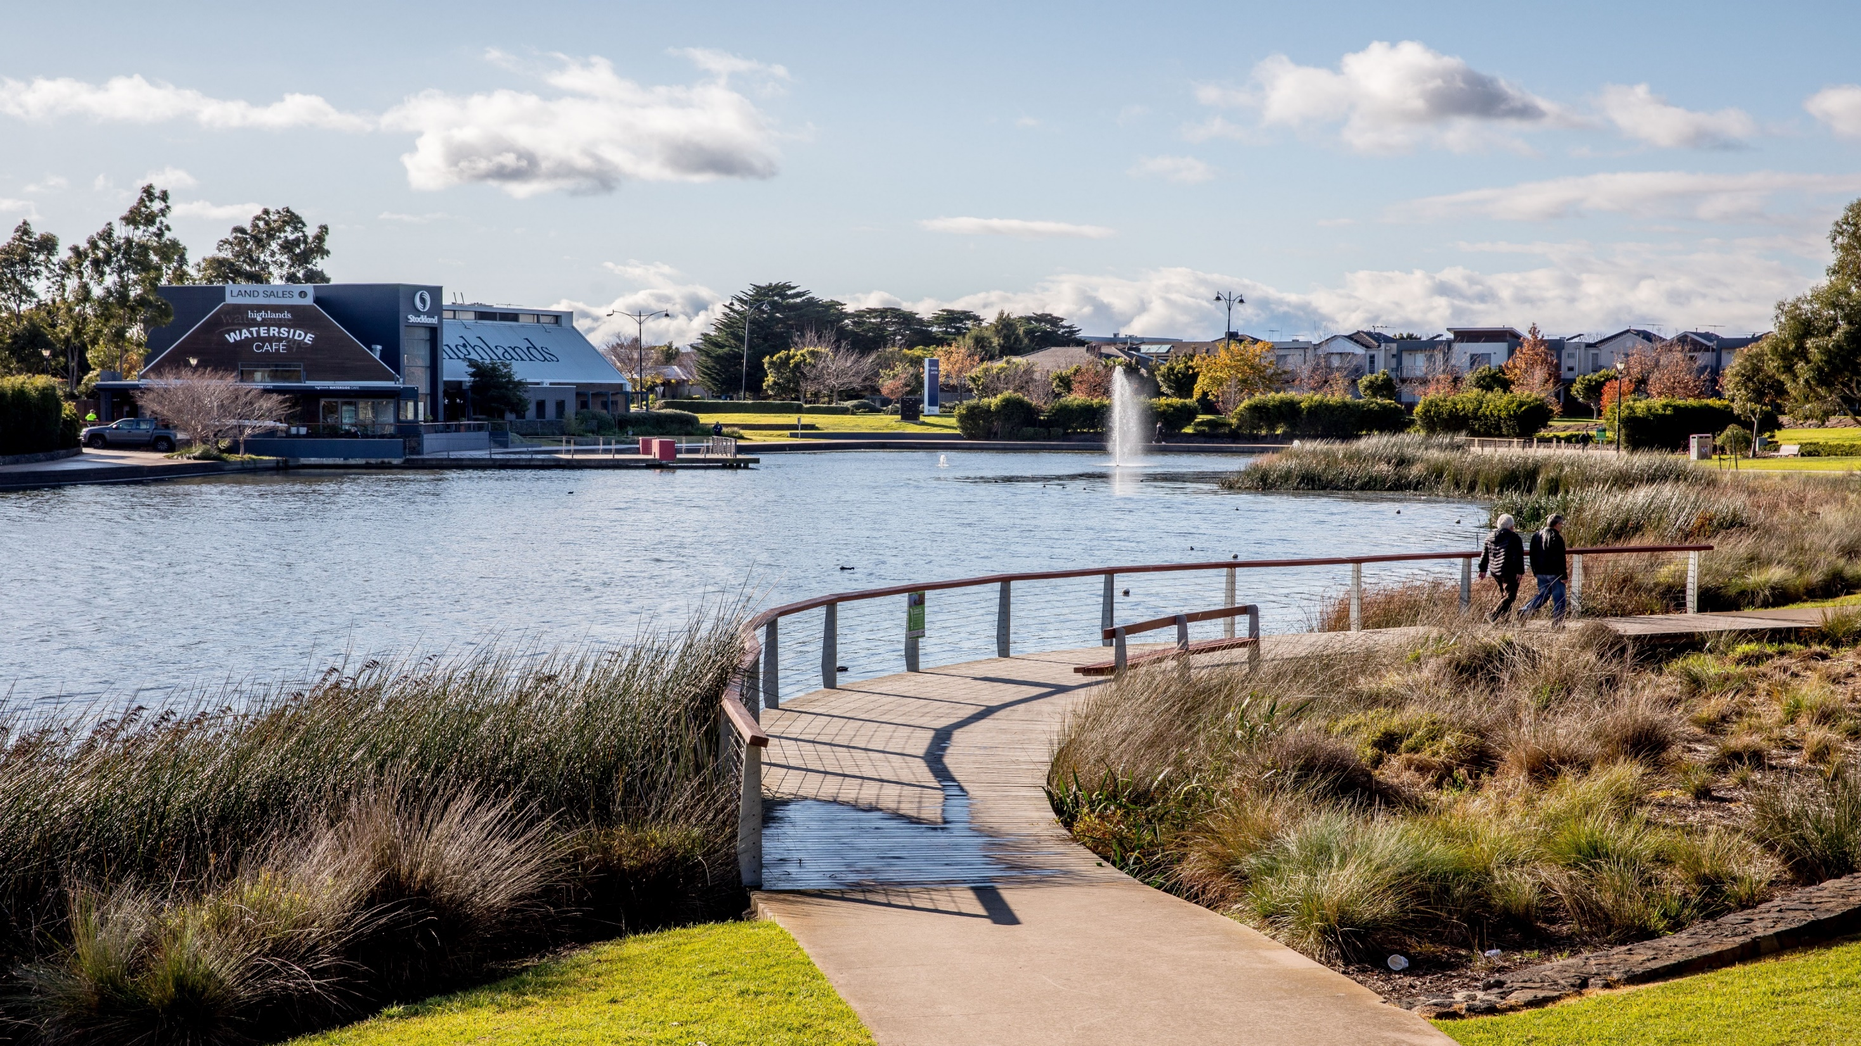
HUME CITY COUNCIL
Economic Development
- Economic Inclusion and the Learning City Approach
Notes:
The role of the Economic Development Department (its purpose) in accordance with the Economic Development Service Plan is to:
Direct necessary resources to support and assist business to become more efficient and sustainable. The service provides leadership and direction that facilitates new investment and fosters employment growth within Hume City. Economic Development is recognised primarily as an externally focused service provided by Council.

Slide 5
HUME CITY BUSINESS AND COMMUNITY DEMOGRAPHICS

Slide 6
A UNIQUE CONTEXT
Hume’s unemployment rate reducing but is still the highest LGA in Victoria
Stronger economic growth than Victorian average
Home to a diverse population who speak 150 languages and bring diverse but not always recognised skills, and entrepreneurial flair
Lower levels of tertiary qualifications
Growing visitor economy
Hume City Council
Notes:
One of the Council Plan Strategic Indicators is to reduce the gap in unemployment between Greater Melbourne and Hume City. The unemployment gap as of the March Quarter (released last month) is now at 2.8% - this is the lowest since December 2015!
In June 2021 when the current Council Plan came into effect it was at 5%.

Slide 7
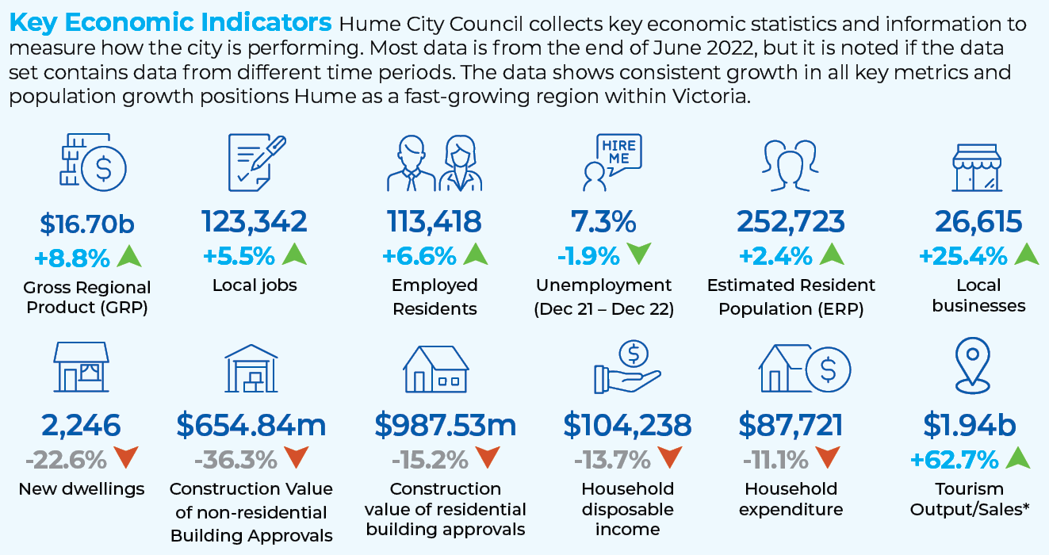

Slide 8
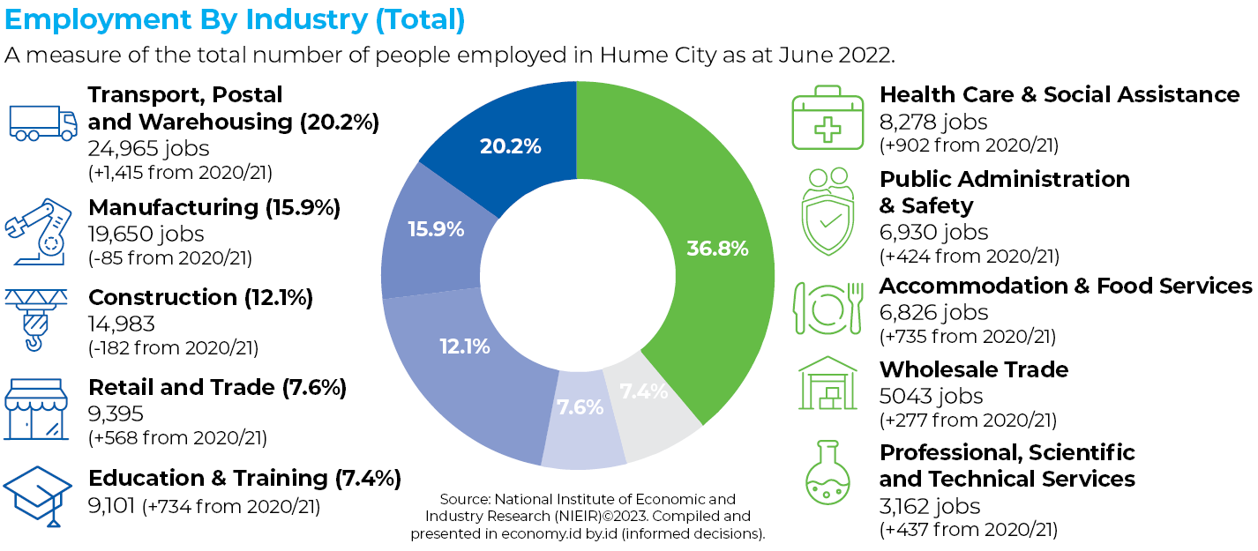

Slide 9
This has led to an innovative approach by economic development
Focus on connecting businesses and our residents looking for work
Long term disadvantage/untapped potential has led to focus on boosting work skills/job readiness – improving economic inclusion
A place-based approach
Innovative- Local Jobs for Local People, Social and Economic Development Program (SEED), Hume Multiversity, Circular Economy, StartNorth
Governance role of Hume Jobs and Skills Task Force
Leveraging our work through partnerships achieves greater impact, attracting significant and longer-term grant funding supported by collaborative program delivery with Multiversity Partners
Hume City Council
Notes:
The primary functions that the service currently delivers are:
Investment Attraction (helping attract new business investment and jobs)
Business Engagement and Development (supporting growth and sustainability of existing businesses and adoption of the Circular Economy)
Local Employment Partnerships, (including Local Jobs for Local People, Labour Market Facilitation and Hume Multiversity)
Visitor Economy (Tourism Development and Visitor Support)
StartNorth (Startup, Entrepreneur and Remote Worker Support)
During the COVID 19 pandemic in 2020/21, additional focus was placed by Council on local economic support followed by economic recovery. In response the Economic Development Department adapted its services early in 2020 and changed delivery at a rapid pace. It adopted a “Zoom in – Zoom out” approach to deal with immediate needs while undertaking longer term planning, in a time of rapid and substantial change. Enhanced labour market support for unemployed residents and local businesses was delivered and an expanded role applied for the Hume Multiversity to improve residents’ level of job skills and qualifications.
Through 2022, the Economic Development Department continued service delivery in accordance with the Council Plan with a strong focus on both internal and external stakeholder engagement and collaboration to achieve objectives.

Slide 10
Pipeline Projects
114 Investment Projects.
Estimated CAPEX value of over $9.15Bn
Estimated over 53,000 Jobs to be created.
54% (62 opportunities) are currently enquiring with us to locate a site or it is a development opportunity.
14% (16 projects) currently have located a site and their permit is being reviewed.
32% (36 projects) have either located a site or their permit has been approved.

Slide 11
Economic Outcomes – Amazon MEL8
First dedicated sort centre in Australia.
Repeat investor.
Construction $72m and CAPEX $65m.
700 construction jobs created.
200 ongoing jobs created. Ranging from entry level positions that will sort customer orders to specialist roles including human resources, workplace health and safety to team leader positions.
$ 112.20m in output and $ 51.53m in value add.
GRP increase estimated $51.5m per annum.
Rates estimate $65,000 per annum

Slide 13
Delivery Outcomes
Local Employment Partnerships
Local Jobs for Local People – Annually, 100+ residents directly supported into jobs, + approx 350 indirectly through jobs expos (30% of total change!)
Hume Multiversity - i.e. 99 local tertiary scholarships at Diploma and Undergrad levels
Social and Economic Development Program (SEED) – economic inclusion model
Support to Council Jobs – i.e. 6 residents recruited for the Venues Team, 3 to Waste Team
Overseas Qualification Recognition - OQP (Melb. Polytechnic) , PREP (LaTrobe Uni)
Hume City Council
Notes:
There are number ways you can look at it.
In the 2021 December Qtr. there were 11,114 residents unemployed in the 2022 December qtr. there were a total of 9360 residents unemployed. This is a drop of 754 residents.
In 2022 we had two successful jobs fair, two Passport to Work programs, the SEED and LJLP outcomes which resulted in approx. 350 placements. As a percentage of the 754 drop of residents unemployed that is placements/drop of residents unemployed 350/754x100 = 46.41% ( I am not sure this is an accurate depiction though as it is too simplistic.)
If you look at this from Mar qtr. 2022 to Mar qtr. 2023 the drop is 1644 and the placements would have been 400 Mar to Mar so the percentage will be 400/1644 x100 = 24.33%. If you take an average of these two i.e., 24.33% + 46.41 = 70.74/2 amounts to 35.37%
Hume’s labour force also increased in these periods from Dec qtr. 2021 to Dec qtr. 2022 by 11,268 and from Mar qtr. 2022 to March qtr. 2023 by 12,181
CASE STUDY
Bachelor of Early Childhood Teaching. Through close collaboration with Councils Family Youth and Children team and Multiversity partner Victoria University, 109 Hume staff/residents have enrolled in Victoria University’s Bachelor of Early Childhood Teaching;
o 2022 Group 1 – 28 (19 current HCC employees)
o 2022 Group 2 – 22 (5 current HCC employees)
o 2023 Group 3 – 30 (number of HCC employees TBC)
o 2023 Group 4 – 29 (number of HCC employees TBC)
•
o Reduced barriers to participation
Students are still able to continue to work alongside their studies, meaning less financial impact on those supporting families. Weekly live online classes are enhanced by monthly face-to-face classes from a local Hume setting. This model has proven effective for this cohort, as many students do not drive and would struggle to attend a campus.
In addition to Council budget, the Economic Development Department has built strong relationships with several State Government Departments. This results in Council receiving substantial funding for a variety of programs from the State Government, most recently with the Office of Suburban Development for StartNorth, and what is now long-term funding for employment programs for the Hume Community Revitalisation Project, via the Department of Jobs, Precincts and Regions. In addition, operational funding support from Victoria University arising from the Sunbury GLC MOU continues to allow for programs such as the Tertiary Scholarships and PREP for residents.
Melbourne’s North Manufacturing Jobs Expo was an industry specific event delivered in partnership with NORTHLink. The event had a total of 10 exhibitors representing manufacturing businesses in Melbourne’s North with a total of 150 diverse Manufacturing jobs. I wanted to share some quick preliminary stats based on the 10 exhibitor evaluation forms collected which are as follows:
• Over 300 jobseekers attended.
• Collectively 295 resumes were collected.
• 39 likely placements
o 8 jobs offers were made on the day.
o 31 in the coming weeks because of the event
Over 44 follow up interviews were organised, and this figure is likely to increase once resumes are reviewed.
There was consensus amongst all exhibitors that the event was well coordinated and seamless. They were also impressed by the venue and the printing station (thanks Prateek). They have all expressed an interest in participating in future Expos.
Some of the comments from exhibitors included:
“Good to meet people from the community Great applicants.”
” Set up was fantastic and great organisation”.

Slide 14
Thank you for your time.
Questions?
Notes:
The Economic Development department continues to focus on delivering against its primary service functions, in support of the Council Plan. Service delivery is flexible and responding to current market conditions including challenging Labour Market trends, increased business investment, an increasing focus on the circular economy along with strong interest in entrepreneurship and start-ups.
The Hume economy is entering a period of growth fuelled by changes arising from the COVID 19 pandemic, facilitated by available and suitably zoned employment land and Council support programs. Council is well placed to ensure residents share in this growth through its employment programs.

Slide 15
Reflections and Q&A
ALCN Friday Forum
22 September 2023

Slide 16
EU Centre of Excellence RMIT Learning and/or earning: Tensions between learning for the economic sphere (jobs) and learning for well-being/democracy Maren Klein, Research Fellow, EU Centre of Excellence, RMIT

Slide 18
The purpose of education and learning: two conceptual points of view
UNESCO
… adult education must be conceived as much more than the parcelling out of ready-made knowledge; … adult education has the task of satisfying the needs and aspirations of adults in all their diversity … One does not start from a pre-fabricated programme or a division of knowledge into the separate subjects set up by traditional schooling; one starts from concrete situations, from real problems which the people concerned have somehow to solve. Adult education is functional also because it is basically free. Nothing can oblige an adult to follow an evening course if he is not drawn to it by a powerful impulse — intellectual, social or artistic. (1949)
… the two-fold perspective of full personal development and participation in balanced and independent social, economic and cultural development … (1976)
… we also see an increase in cultural and religious intolerance, identity-based political mobilization and conflict. … Education must find ways of responding to such challenges, taking into account multiple worldviews and alternative knowledge systems, as well as new frontiers in science and technology such as the advances in neurosciences and the developments in digital technology. Rethinking the purpose of education and the organization of learning has never been more urgent. (2015)
OECD
(a) to achieve the highest sustainable economic growth and employment and a rising standard of living in Member countries, while maintaining financial stability, and thus to contribute to the development of the world economy … (1960)
Governments need a clear picture not only of how markets and economies are changing, but of the extent to which their citizens are equipping themselves with the skills demanded in the 21st century” (2013)
Need for solutions in a rapidly changing world … education can make the difference as to whether people embrace the challenges they are confronted with or whether they are defeated by them.
For at least a decade, lifelong learning has been considered essential for individuals and societies to navigate a rapidly changing world of work shaken by globalisation, technological and environmental changes as well as demographic changes. In the aftermath of the Covid-19 pandemic, it is essential that lifelong learning becomes a reality to all individuals since the crisis has further accelerated the transformation in our economy and skills needs. (2018)

Slide 19
The value of education… in times of change
The linear education-to-work transition that was the dominant pattern for decades is becoming less relevant as, increasingly, adults follow complex trajectories over their working life (MFA 2022)
… the challenges humanity faces, those resulting from the climate crisis and from technological and demographic change, not to mention those posed by the COVID-19 pandemic and the inequalities it has exacerbated, call for societies that understand themselves as learning societies and people who identify themselves as learners throughout their lives. This implies seeing education as more than an economic transaction and acknowledging its public and private value (UIL, 2020)

Slide 20
Everyday tensions/barriers adult learners (might) face
Cost of education
Time pressures
Family commitments
Access – distance
Access – prior education
Access – gaining credit for formal, informal and non-formal learning
Availability of programs, advice, part-time, flexible options
Prior experiences

Slide 21
A selection of tools to address tensions
Credit and recognition of prior learning
Micro-credentials
Programs that combine acquisition of practical skills and advanced theoretical knowledge

Slide 22
Credit and recognition of prior learning
Credit is a recognition of equivalence in content and learning outcomes between different types of learning and/or qualifications.
may be granted through credit transfer, articulation, RPL or advanced standing (TEQSA, 2023)
Recognition of Prior Learning (RPL) is an assessment of an individual’s prior learning to determine whether credit will be granted. RPL includes formal, informal, and non-formal learning. (TEQSA, 2023)
Pros:
Credit can reduce the amount of learning required to achieve a qualification, thus addressing time and financial constraints
Cons:
Time consuming; can be difficult to achieve, especially in case of RPL; requires careful consideration and good academic judgement so as to not impede student progress

Slide 23
Micro-credentials
The education landscape is changing with growing demand for shorter-form courses that enable workers to rapidly upskill and encourage lifelong learning.
The framework defines microcredentials as a certification of assessed learning or competency, with a minimum volume of learning of one hour and less than an AQF award qualification, that is additional, alternate, complementary to or a component part of an AQF award qualification. (Australian Government, Department of Education, 2021)
A micro-credential is a certified small volume of learning. (Common definition, Common Framework for Micro-credentials in the EHEA, 2022)
A micro-credential is the record of the learning outcomes that a learner has acquired following a small volume of learning. These learning outcomes have been assessed against transparent and clearly defined standards. Courses leading to micro-credentials are designed to provide the learner with specific knowledge, skills and competences that respond to societal, personal, cultural or labour market needs. Micro-credentials are owned by the learner, can be shared and are portable. They may be standalone or combined into larger credentials. They are underpinned by quality assurance following agreed standards in the relevant sector or area of activity. (European Commission, 2012)
https://www.microcredseeker.edu.au/

Slide 24
Programs that combine acquisition of practical skills and advanced theoretical knowledge
Example: German dual study programs
a study program combining academic/theoretical content with vocational training (employment)/extended periods of work experience with an employer; vocational/employment component is an integral and extensive part of the overall degree program.
Two forms at the undergraduate level:
HE program plus formal vocational/professional training component undertaken at the employer’s site(s); combines provision of overarching theoretical knowledge with practical training in a federally recognised occupation leading to two qualifications: a bachelor degree and a vocational/professional qualification. Entry requirements generally include an employment contract and a university/university of applied science entry certification.
HE program with extensive work experience phases with an employer; combines provision of overarching theoretical knowledge with extended training phases in a recognised occupation in a workplace. Only one qualification, a bachelor degree.
Pros:
Possibly 2 qualifications, salary/wages component, socialisation into world of work, network, often leads to employment
Cons:
Very labour intensive; may lead to employers’ having an outsize influence on program development/determination

Slide 25
Thank you for your time Do you have any questions?

Slide 26
Reflections and Q&A
ALCN Friday Forum
22 September 2023

Slide 27
Thank You For more information about The Australian Learning Communities Network go to https://alcn.com.au/ or email alcn@bigpond.com FB: https://www.facebook.com/aus.alcn
ALCN Friday Forum
22 September 2023

